Slide 1
Moving Beyond Linearity: Smoothing Splines and
Local Regression
ISLR § 7.5 and 7.6
Hope Albers
Geoff Bernstein
Knot Chodsawang
Garrett McInnes
Notes:
Sections 7.5 and 7.6

Slide 2
Smoothing Splines
Knot Chodsawang & Garrett McInnes

Slide 3
The Spline Review
Regression Spline
A set of piecewise polynomial functions that are fit through regions of a set of data, with each region being defined at points called knots.
Smoothness and Regression Splines
A general regression spline is subject to each polynomial fit between the knots. The “smoothness” of the spline is subject to the degree of the polynomial and knot placement.
Why Do We Care About Smoothness?
“Natura non facit saltus” - Nature does not make leaps. When you have data measured over space, distance, or time, you should smooth. Smoothing helps us make estimations from discrete data based on naturally continuous phenomena
Notes:
Adding context to smoothing splines

Slide 4

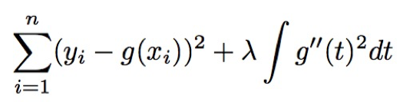
Smoothing Splines
Smoothing Spline Formulation
A singular smooth function, that fits an observed dataset well. as determined by having the minimizing the function’s residual sum of squares
An approach to this solution is to find a function, g(x_{i} ) to fit the y values is found by minimizing the expression:
Where λ is our tuning parameter
′
′
Notes:
the penalty term is proportional to the non-smoothness of g(x) – a large penalty value mean g(t) is very bendy within the range of the x’s and a small penalty value means that g(t) is smooth within the range of x’s.
The notation is an integral, which we can think of as a summation over
the range of t. In other words, integral g′′(t) 2 dt is simply a measure of the total change in the function g′(t), over its entire range. If g is very smooth, then
g′(t) will be close to constant and 5 g′′(t) 2 dt will take on a small value.
Conversely, if g is jumpy and variable then g′(t) will vary signiﬁcantly and
Integral g′′(t) 2 dt will take on a large value. Therefore, in (7.11), λ 5 g′′(t) 2 dt encourages g to be smooth. The larger the value of λ, the smoother g will be.
λ indexes models ranging from a straight line fit to the interpolating model.
ESL 2.9 Model Selection and the Bias–Variance Tradeoff
All the models described above and many others discussed in later chapters have a smoothing or complexity parameter that has to be determined:
• the multiplier of the penalty term; • the width of the kernel;
• or the number of basis functions.
In the case of the smoothing spline, the parameter λ indexes models ranging from a straight line fit to the interpolating model. Similarly a local degree- m polynomial model ranges between a degree-m global polynomial when the window size is infinitely large, to an interpolating fit when the window size shrinks to zero. This means that we cannot use residual sum-of-squares on the training data to determine these parameters as well, since we would always pick those that gave interpolating fits and hence zero residuals. Such a model is unlikely to predict future data well at all.
– As λ → 0, roughness matters less and less, and x(t) fits the data better and better.
– As λ → ∞, roughness matters more and more, and x(t) becomes more and more “hyper–smooth.”

Slide 5
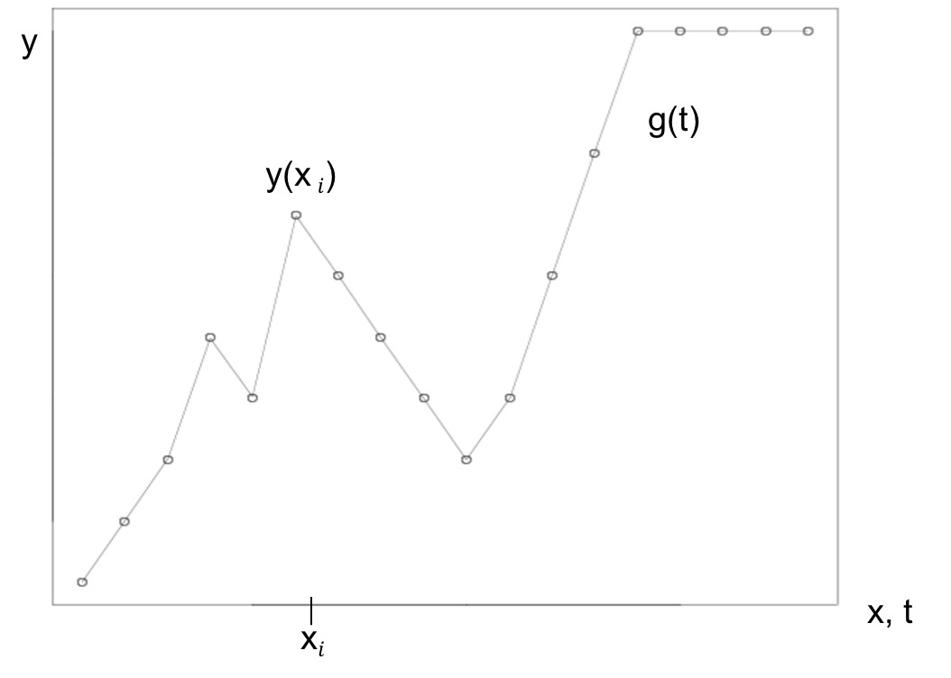
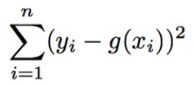
Smoothing Splines
Loss term
The loss term represents the residual sum of squares function that guides a good fit to the data set
This is also the Residual Sum of Squares term from linear regression, with the inclusion of the function g(x_{i}).
If there are no constraints on this term, the RSS can always minimize to zero by fitting a function g that passes through each observation (x,y)
This would lead to a strict interpolation of y and overfit of the dataset
′
′
Notes:
the penalty term is proportional to the non-smoothness of g(x) – a large penalty value mean g(t) is very bendy within the range of the x’s and a small penalty value means that g(t) is smooth within the range of x’s.
The notation is an integral, which we can think of as a summation over
the range of t. In other words, integral g′′(t) 2 dt is simply a measure of the total change in the function g′(t), over its entire range. If g is very smooth, then
g′(t) will be close to constant and 5 g′′(t) 2 dt will take on a small value.
Conversely, if g is jumpy and variable then g′(t) will vary signiﬁcantly and
Integral g′′(t) 2 dt will take on a large value. Therefore, in (7.11), λ 5 g′′(t) 2 dt encourages g to be smooth. The larger the value of λ, the smoother g will be.
λ indexes models ranging from a straight line fit to the interpolating model.
ESL 2.9 Model Selection and the Bias–Variance Tradeoff
All the models described above and many others discussed in later chapters have a smoothing or complexity parameter that has to be determined:
• the multiplier of the penalty term; • the width of the kernel;
• or the number of basis functions.
In the case of the smoothing spline, the parameter λ indexes models ranging from a straight line fit to the interpolating model. Similarly a local degree- m polynomial model ranges between a degree-m global polynomial when the window size is infinitely large, to an interpolating fit when the window size shrinks to zero. This means that we cannot use residual sum-of-squares on the training data to determine these parameters as well, since we would always pick those that gave interpolating fits and hence zero residuals. Such a model is unlikely to predict future data well at all.
– As λ → 0, roughness matters less and less, and x(t) fits the data better and better.
– As λ → ∞, roughness matters more and more, and x(t) becomes more and more “hyper–smooth.”

Slide 6

Smoothing Splines
Penalty term
General term for the measure of the “roughness" of the function.
Breaking this term down further:
The term g”(t) is the second derivative of the function g
This describes the changing in the slope of this function
The integral is the summation of the values over the range of x_{i}
Needed because an integral cannot be taken over a discrete set of values
This penalty term is the measure of the total change of this function g(t) over the range of x-values
Minimizing this term determines how smooth our function will be with g(x) being smoother the larger the value of λ
′
′
Notes:
the penalty term is proportional to the non-smoothness of g(x) – a large penalty value mean g(t) is very bendy within the range of the x’s and a small penalty value means that g(t) is smooth within the range of x’s.
The notation is an integral, which we can think of as a summation over
the range of t. In other words, integral g′′(t) 2 dt is simply a measure of the total change in the function g′(t), over its entire range. If g is very smooth, then
g′(t) will be close to constant and 5 g′′(t) 2 dt will take on a small value.
Conversely, if g is jumpy and variable then g′(t) will vary signiﬁcantly and
Integral g′′(t) 2 dt will take on a large value. Therefore, in (7.11), λ 5 g′′(t) 2 dt encourages g to be smooth. The larger the value of λ, the smoother g will be.
λ indexes models ranging from a straight line fit to the interpolating model.
ESL 2.9 Model Selection and the Bias–Variance Tradeoff
All the models described above and many others discussed in later chapters have a smoothing or complexity parameter that has to be determined:
• the multiplier of the penalty term; • the width of the kernel;
• or the number of basis functions.
In the case of the smoothing spline, the parameter λ indexes models ranging from a straight line fit to the interpolating model. Similarly a local degree- m polynomial model ranges between a degree-m global polynomial when the window size is infinitely large, to an interpolating fit when the window size shrinks to zero. This means that we cannot use residual sum-of-squares on the training data to determine these parameters as well, since we would always pick those that gave interpolating fits and hence zero residuals. Such a model is unlikely to predict future data well at all.
– As λ → 0, roughness matters less and less, and x(t) fits the data better and better.
– As λ → ∞, roughness matters more and more, and x(t) becomes more and more “hyper–smooth.”

Slide 7
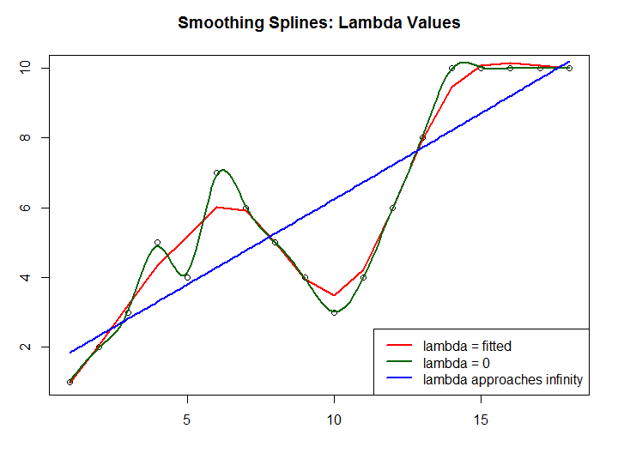
Smoothing Splines
Tuning with Lambda
The equation of fit can be seen in its extremes with a linear model and a spline fit at every knot
The tuning parameter, λ , prevents ‘jumpiness’, and creates a smooth spline through each unique x_{i}
When λ = 0, g(x) is allow to perfectly fit a function to each of the observations
As λ → ∞, g(x) will be a straight line through the dataset
Overall Function Structure
The function g(x) can be shown to be a cubic polynomial with knots at each unique value of unique x_{i}
Also this function is linear in the regions outside of the extreme knots
λ → ∞
λ = 0
g(x)

Slide 8
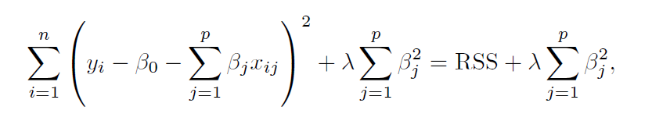
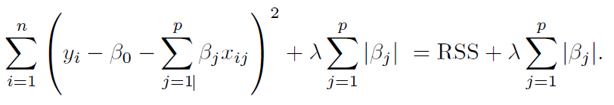
Smoothing Splines
The Tuning Parameter, λ Comparisons
λ controls the degree of smoothing of the function between each knot in our function, with the
The “loss and penalty” with a tuning parameter formulation have been used before in shrinkage methods ridge regression and lasso
Ridge Regression
Lasso
Ridge Regression and Lasso methods shrink the effects of the beta coefficients. The smoothing spline term shrinks the variability in g(x)
′
′
Notes:
the penalty term is proportional to the non-smoothness of g(x) – a large penalty value mean g(t) is very bendy within the range of the x’s and a small penalty value means that g(t) is smooth within the range of x’s.
The notation is an integral, which we can think of as a summation over
the range of t. In other words, integral g′′(t) 2 dt is simply a measure of the total change in the function g′(t), over its entire range. If g is very smooth, then
g′(t) will be close to constant and 5 g′′(t) 2 dt will take on a small value.
Conversely, if g is jumpy and variable then g′(t) will vary signiﬁcantly and
Integral g′′(t) 2 dt will take on a large value. Therefore, in (7.11), λ 5 g′′(t) 2 dt encourages g to be smooth. The larger the value of λ, the smoother g will be.
λ indexes models ranging from a straight line fit to the interpolating model.
ESL 2.9 Model Selection and the Bias–Variance Tradeoff
All the models described above and many others discussed in later chapters have a smoothing or complexity parameter that has to be determined:
• the multiplier of the penalty term; • the width of the kernel;
• or the number of basis functions.
In the case of the smoothing spline, the parameter λ indexes models ranging from a straight line fit to the interpolating model. Similarly a local degree- m polynomial model ranges between a degree-m global polynomial when the window size is infinitely large, to an interpolating fit when the window size shrinks to zero. This means that we cannot use residual sum-of-squares on the training data to determine these parameters as well, since we would always pick those that gave interpolating fits and hence zero residuals. Such a model is unlikely to predict future data well at all.
– As λ → 0, roughness matters less and less, and x(t) fits the data better and better.
– As λ → ∞, roughness matters more and more, and x(t) becomes more and more “hyper–smooth.”

Slide 9
Smoothing Splines
Effective Degrees of Freedom
Since the function g(x) has knots at each unique x_{i} , this function would have a very large set of degrees of freedom
The tuning parameter λ controls the degree of smoothing of the function between each knot in the function
Effective degrees of freedom is the term used to describe this flexibility
It is possible to show that as λ increases from 0 to infinity, the effective degrees of freedom, decreases from n to 2
Finding the best fit for λ
λ can be easily found using a Leave-One Out Cross Validation (LOOCV) to minimize the RSS and penalty term to find the function g(x)
′
′
Notes:
the penalty term is proportional to the non-smoothness of g(x) – a large penalty value mean g(t) is very bendy within the range of the x’s and a small penalty value means that g(t) is smooth within the range of x’s.
The notation is an integral, which we can think of as a summation over
the range of t. In other words, integral g′′(t) 2 dt is simply a measure of the total change in the function g′(t), over its entire range. If g is very smooth, then
g′(t) will be close to constant and 5 g′′(t) 2 dt will take on a small value.
Conversely, if g is jumpy and variable then g′(t) will vary signiﬁcantly and
Integral g′′(t) 2 dt will take on a large value. Therefore, in (7.11), λ 5 g′′(t) 2 dt encourages g to be smooth. The larger the value of λ, the smoother g will be.
λ indexes models ranging from a straight line fit to the interpolating model.
ESL 2.9 Model Selection and the Bias–Variance Tradeoff
All the models described above and many others discussed in later chapters have a smoothing or complexity parameter that has to be determined:
• the multiplier of the penalty term; • the width of the kernel;
• or the number of basis functions.
In the case of the smoothing spline, the parameter λ indexes models ranging from a straight line fit to the interpolating model. Similarly a local degree- m polynomial model ranges between a degree-m global polynomial when the window size is infinitely large, to an interpolating fit when the window size shrinks to zero. This means that we cannot use residual sum-of-squares on the training data to determine these parameters as well, since we would always pick those that gave interpolating fits and hence zero residuals. Such a model is unlikely to predict future data well at all.
– As λ → 0, roughness matters less and less, and x(t) fits the data better and better.
– As λ → ∞, roughness matters more and more, and x(t) becomes more and more “hyper–smooth.”

Slide 10
Lab: Smoothing Splines
Smoothing Splines and Examples

Slide 11
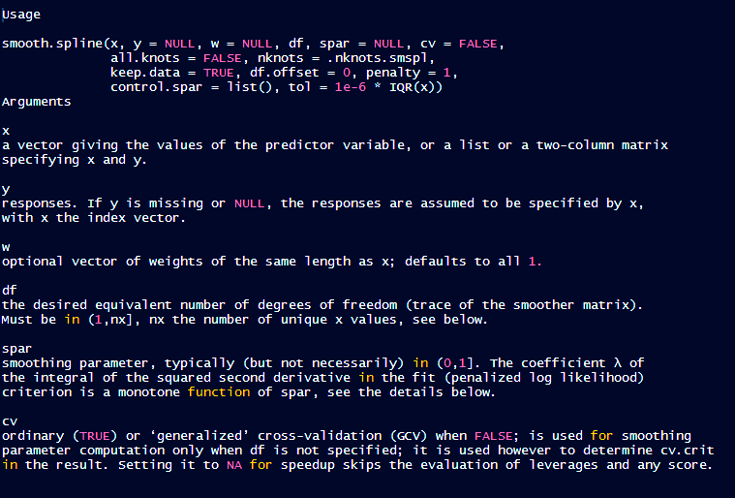
Smoothing Spline Function in R

Slide 12
2. Local Regression
Hope Albers & Geoff Bernstein

Slide 13
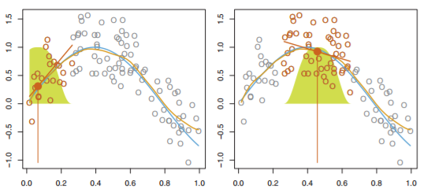
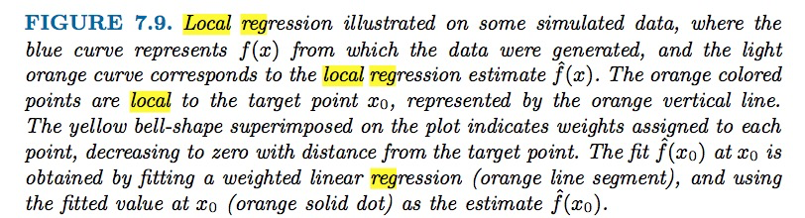
Local Regression
Local regression uses linear methods paired with KNN to fit a tangent slope to a point in the scatterplot
Local Regression is a non-parametric method, meaning instead of mathematically establishing parameters to describe how a relationship works within the data, we’re mapping a line to existing data
We’re not assuming a distribution, an underlying structure, or even the relationship within the data--we’re lining the data up, applying an algorithm, describing a relationship as it exists, and letting the data speak for itself.
When should we use Local Regression?
Nonparametric regression can be adjusted to capture unusual or unexpected features of the data. When the relationship between the response and explanatory variables is known, parametric regression models should be used. Local regression is useful for modeling unknown, nonlinear relationships in the data.
Algorithmic, point- based regression
Can I say…..data-agnostic?
Notes:
the penalty term is proportional to the non-smoothness of g(x) – a large penalty value mean g(t) is very bendy within the range of the x’s and a small penalty value means that g(t) is smooth within the range of x’s.
Algorithmic, point-based regression
Can I say…..data-agnostic?
Algorithmic, point-based regression
Can I say…..data-agnostic?
Nonparametric regression differs from parametric regression in that the shape of the functional relationships between the response (dependent) and the explanatory (independent) variables are not predetermined but can be adjusted to capture unusual or unexpected features of the data.
When the relationship between the response and explanatory variables is known, parametric regression models should be used.
If the relationship is unknown and nonlinear, nonparametric regression models should be used.

Slide 14
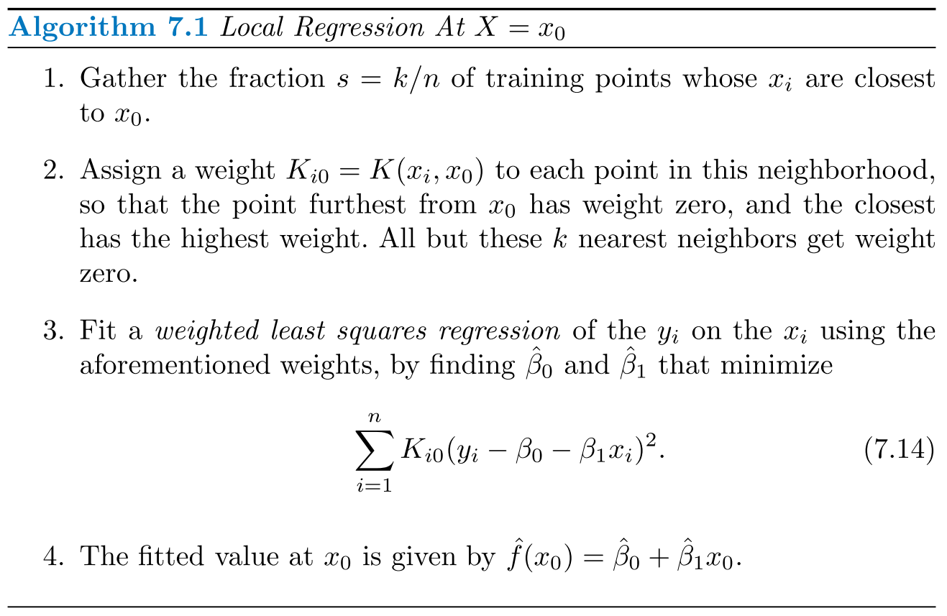
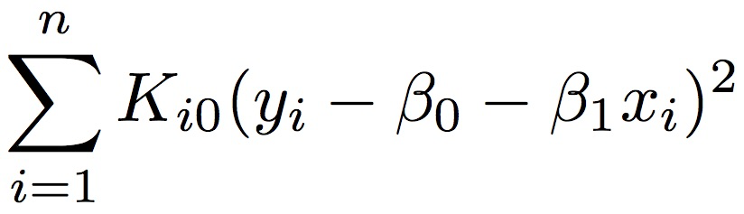
Local Regression Algorithm
Gather the fraction s = k/n of training points whose x_{i} are closest to x₀
- S or span will determine the flexibility of the mode
- Acts like a tuning parameter
- Small S = more local/wiggly fit
- Large S = more global interpolation since all the data will be used
Assign a weight K_{i0} = K (x_{i} , x₀) to each point in this neighborhood, so that the point furthest from x₀ has weight zero, and the closest has the highest weight. All but these k nearest neighbors get weight zero
K_{i0} is the i-th point = weight times x, y point
The values closer to the center value are higher weights than the points that are farther away since they are more likely to influence the shape of the line
Fit a weighted least squares regression of the y_{i} on the x_{i} using the aforementioned weights, by finding β₀ and β₁ that minimize
The fitted value at x₀ is given by f ( x₀ ) = β₀ + β₁ x₀
^ ^ ^
Notes:
In order to perform local regression, there are a number of choices to be made, such as how to define the weighting function K, and whether to fit a linear, constant, or quadratic regression in Step 3 above. (Equation 7.14 corresponds to a linear regression.) While all of these choices make some difference, the most important choice is the span s

Slide 15
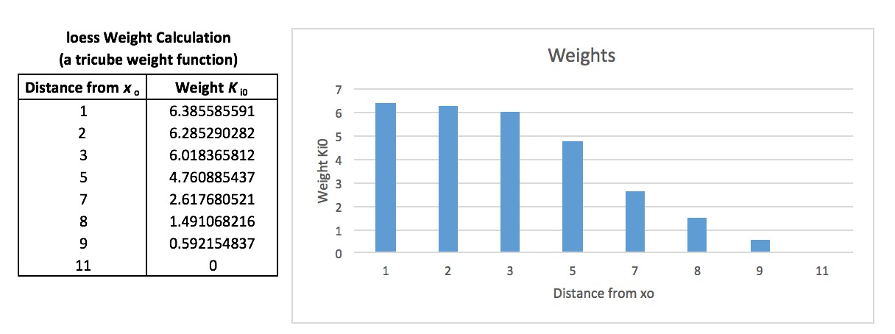
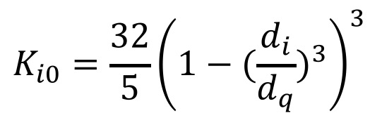
Calculating K_{i0}
Suppose q denotes the number of points in the local neighborhood of x₀ and d₁ , d₂ … d_{q} denote the distances in increasing order of the q points closest to x₀ (i.e., furthest to closest)
The point at distance d_{i} from x₀ is given a weight K_{i0} in the local regression that decreases as the distance from x₀ increases.
The loess() function uses a tricube
weight function to define K_{i0} as follows:

Slide 16
Local Regression in R
R has two functions for producing lowess fits: lowess() and loess(). The loess() function is a newer, formula-based version of lowess() and is more powerful. The two functions have different defaults, so be careful not to confuse them.
R in Action, pg 266
LOESS (1996)
Can accept a formula specifying the model rather than the x and y scatterplot
It can be used with more than one predictor
It accepts prior weights.
It will estimate the "equivalent number of parameters" implied by the fitted curve.
LOWESS (1981)
Much faster
Sometimes produces an output when LOESS fail
Allows for only one predictor
Notes:
locally weighted scatterplot smoothing

Slide 17

Lab: Local Regression
LOESS vs. LOWSS
From W.S. Cleveland. Get It? It’s not really that funny

Slide 18
Citations
“10 things statistics taught us about big data Analysis”, Simply Statistics Blog. http://simplystatistics.org/2014/05/22/10-things-statistics-taught-us- about-big-data-analysis/, Rafa Irizarry, Roger Peng, and Jeff Leek. Created 20140522, accessed 20170204.
“LOWESS vs. LOESS” , R Bioconductor Mailing List https://stat.ethz.ch/ pipermail/ bioconductor/2003-September/002337.html. Smyth, Gordon. Created 20030903, accessed 20170205.
An Introduction to Statistical Learning with Applications in R, 6th Printing. Gareth James, Daniela Witten, Trevor Hastie and Robert Tibshirani. New York: Springer Texts, 2015.
Schimek, Michael G. Smoothing and regression: approaches, computation, and application. New York: Wiley, 2000. Print.

Slide 19
Any questions?

